Slide 1
CONTROLLING
CONTROLLING PROCESS
Business Studies
Class 12
UNIT -8::MODULE -2
By
ABHISHIKTH SANDEEP ABRAHAM
M.Phil, M.Com, MA(Pub.Rel & Journl), MBA (HR),B.Ed, BCJ,
ICWAI(I), PGDT, PGDCMP, Dip.Tax, CDT, UGC-NET,APSLET,
(PhD),UGC-MAN Research Fellow Awardee in Devp. Studies

Slide 2
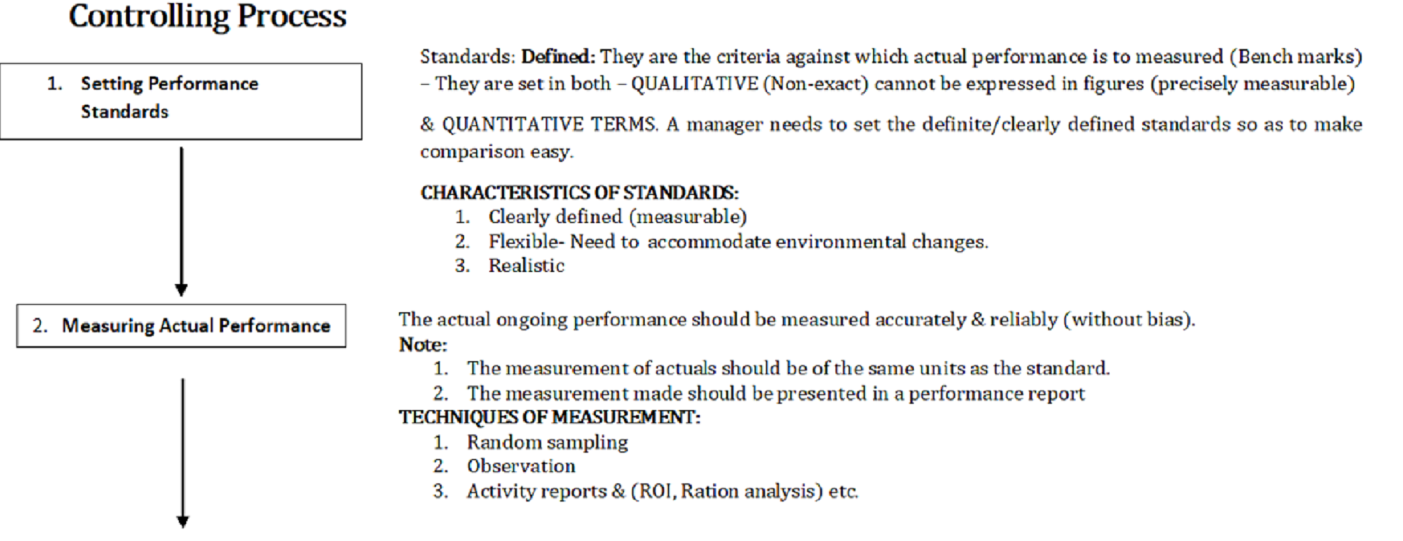
STEPS IN CONTROLLING PROCESS
STEPS
Contd……

Slide 3
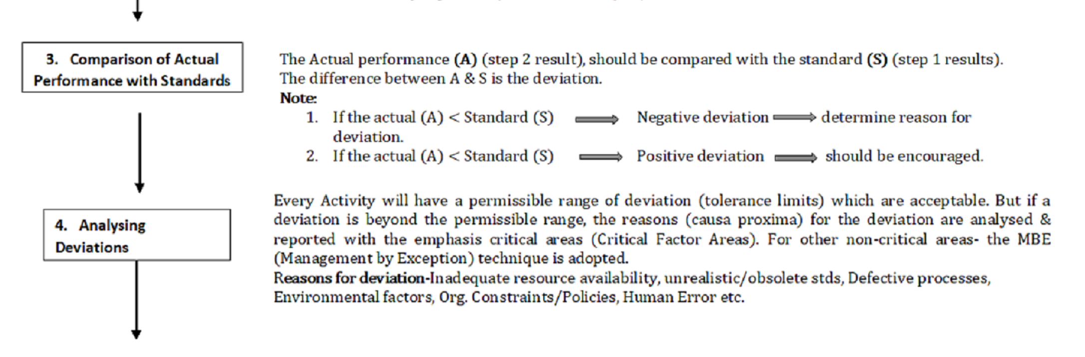
Contd. from previous slide
Contd……

Slide 4
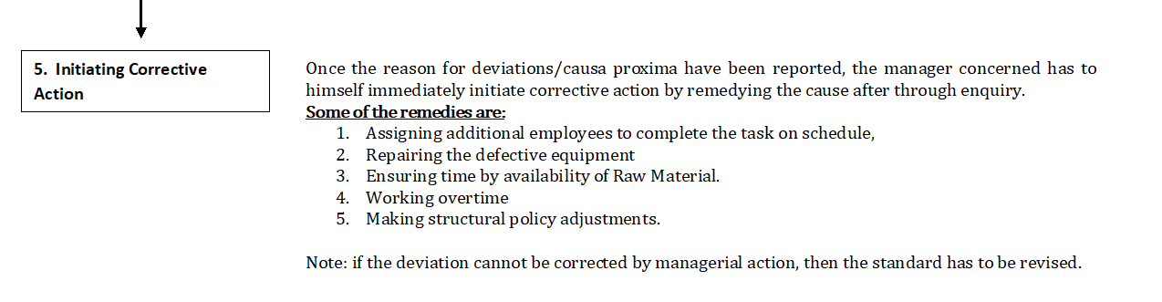
Contd..from previous slide

Slide 5
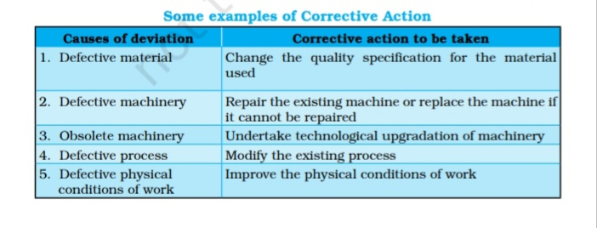
SOURCE: NCERT business Studies ,class 12 Text book

Slide 6
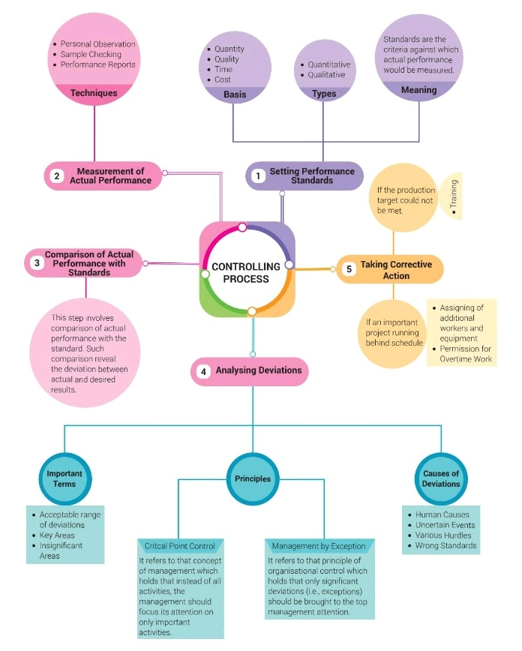
RECAPITULATION
Source: Business Studies-Class 12, CBSE.
R.K.Singla. VK Publications

Slide 7
WORKSHEET
Explain the steps in the controlling process. ( 5 marks)
Define deviation. (1 mark)
____ types of goals are not quantifiable. (1 mark)
If an organization’s actions are not in consonance with plans, managers should take ____ action immediately. (1 mark)
Seeking customer feedback is one way of comparing _____ with ultimate goals and standards (1 mark)
One way of reducing ____________ from employees is for managers to include employees while setting standards and making plans. (1 mark)

